Slide 1
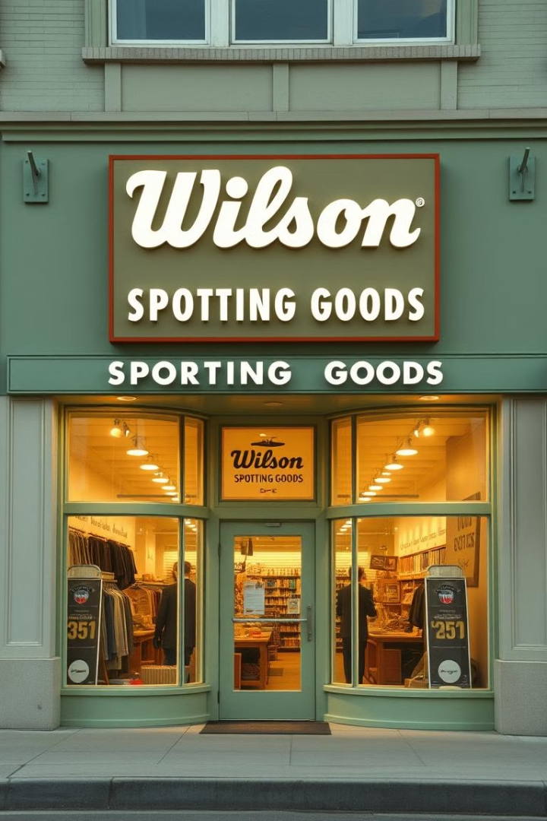
Wilson Sporting Goods: A Legacy of Innovation
By Mohamed Adnan Shaikh - 07

Slide 2

Industry Overview
Wilson Sporting Goods operates within the sporting goods industry.
The global sporting goods market is substantial and continues to grow. As of 2023, the market size is estimated to be around USD 721.9 billion.
Wilson's annual revenue is over USD 500 million.
Competitors
Nike holds a dominant market share of approximately 38.13% in the global sportswear segment
Adidas holds approximately 11% of the global sports footwear market
Wilson Sporting Goods holds approximately 9% of the sportswear market
https://www.statista.com/forecasts/1351971/wilson-sportswear-brand-profile-in-the-united-states?form=MG0AV3

Slide 3
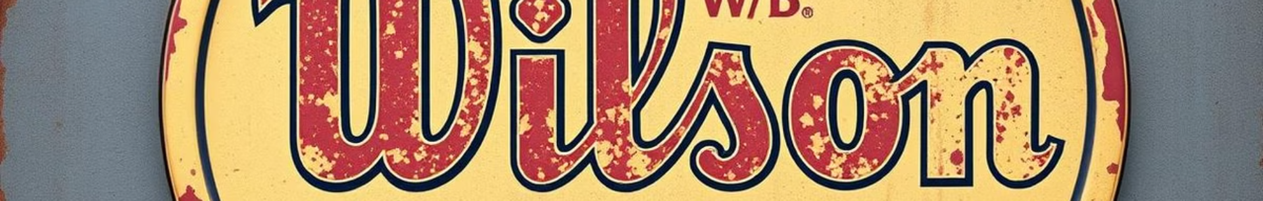

From Humble Beginnings to Global Success
1913 - Founding
1960s - Global Growth
Wilson Sporting Goods was founded in Chicago
Worldwide existence
1920s - Expansion
The company expanded into new sports

Slide 4
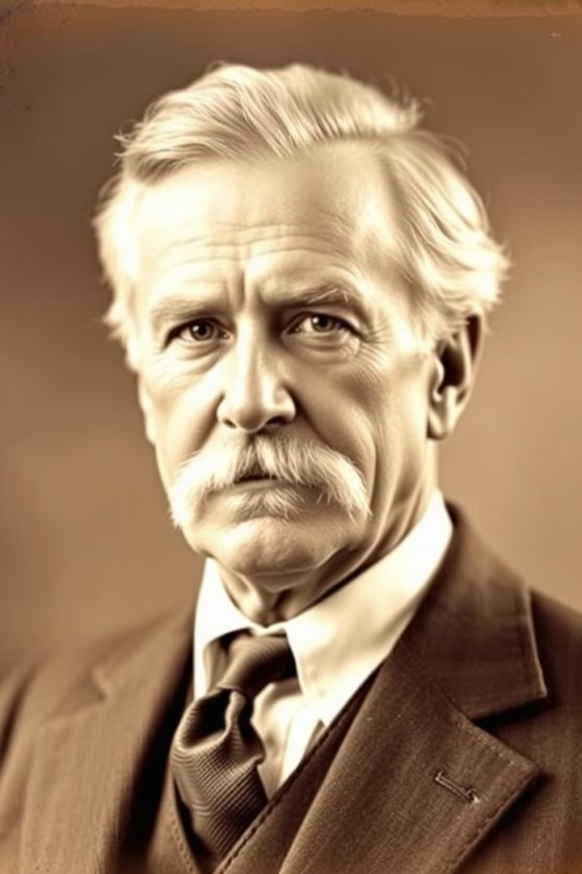
History and Founder
Thomas E. Wilson
Innovation Driven
The company's founder, Thomas E. Wilson, was a visionary entrepreneur who recognized the growing demand for high-quality sporting goods.
Under Wilson's leadership, the company pioneered new technologies and materials to create industry-leading products.
Enduring Legacy
Today, Wilson Sporting Goods continues to build on its founder's legacy, remaining a driving force in the sports equipment industry.

Slide 5
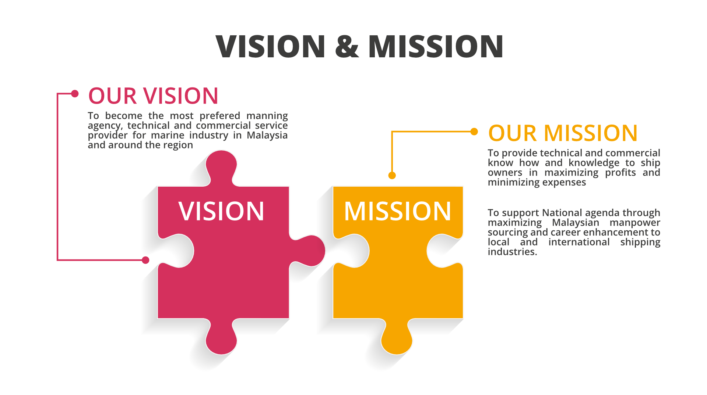
The Vision of Wilson Sporting Goods is to be the world’s leading equipment.
The Mission of Wilson Sporting Goods is dedicated to empower athletes through
innovative products.

Slide 6
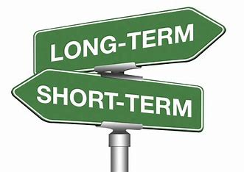
Goals
Over the next five years, Wilson aspires to grow its international market share by 20%, invest in sustainable product practices and strengthen brand loyalty.
In next year, Wilson aims to innovate its product lines, enhance online sales channels, and improve customer engagement

Slide 7
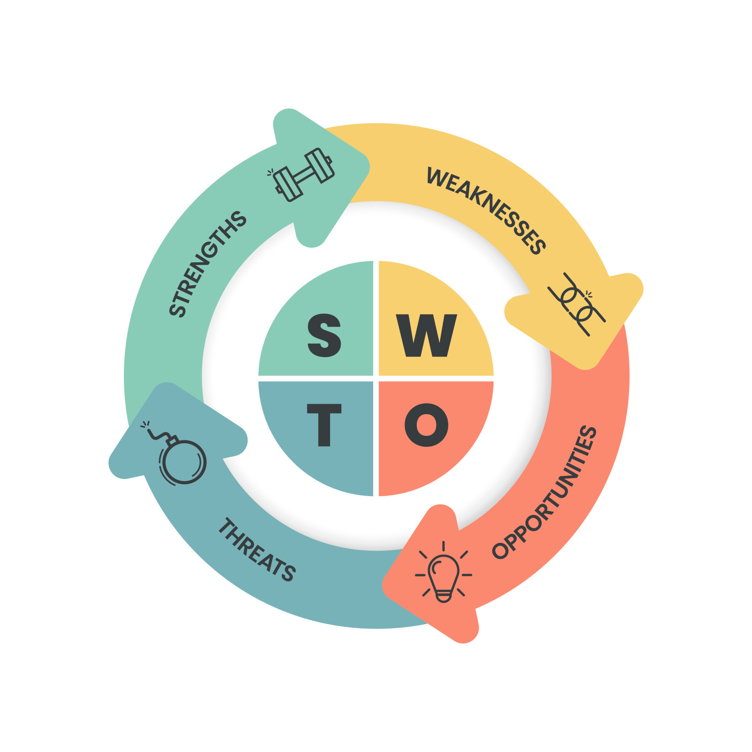
SWOT ANALYSIS
STRENGTHS | WEAKNESSES
Strong brand reputation | Reliance on partnerships
Diverse range of products | Limited presence in some regions
OPPORTUNITIES | THREATS
Market expansion | Economic factors
E-commerce marketing | Intense competition

Slide 8
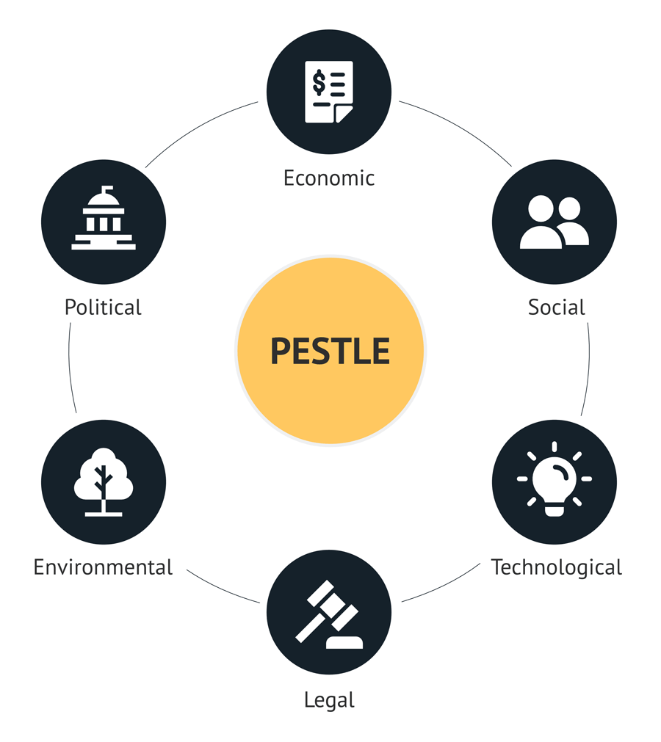
PESTLE Analysis
Political
Regulations, Government Policies
Economic
Consumer Spending, Exchange Rates
Social
Health Trends, Demographics
Technological
Innovation, Digital Transformation
Legal
Intellectual Property, Consumer Protection Laws
Environmental
Sustainability, Environmental Regulations

Slide 9
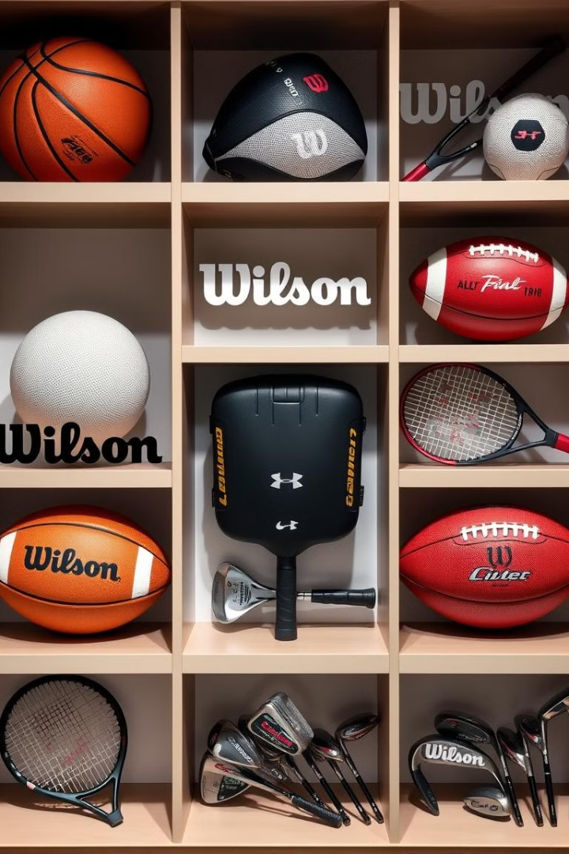
PRODUCT PORTFOLIO
SPORT | PRODUCTS
Tennis | Rackets, balls, apparel
Baseball | Bats, gloves, balls
Football | Game balls, training equipment
Basketball | Game balls, apparel
Golf | Clubs, balls, accessories
Volleyball | Balls, apparel
Pickleball | Paddles, balls

Slide 10

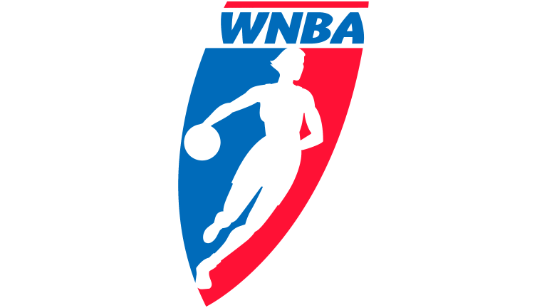


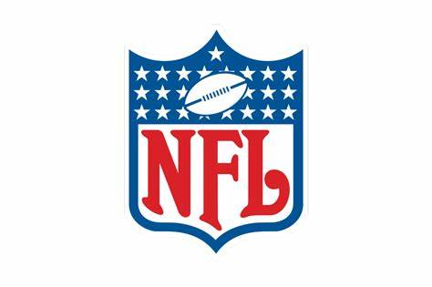
Wilson Sporting Goods Partnerships

Slide 11
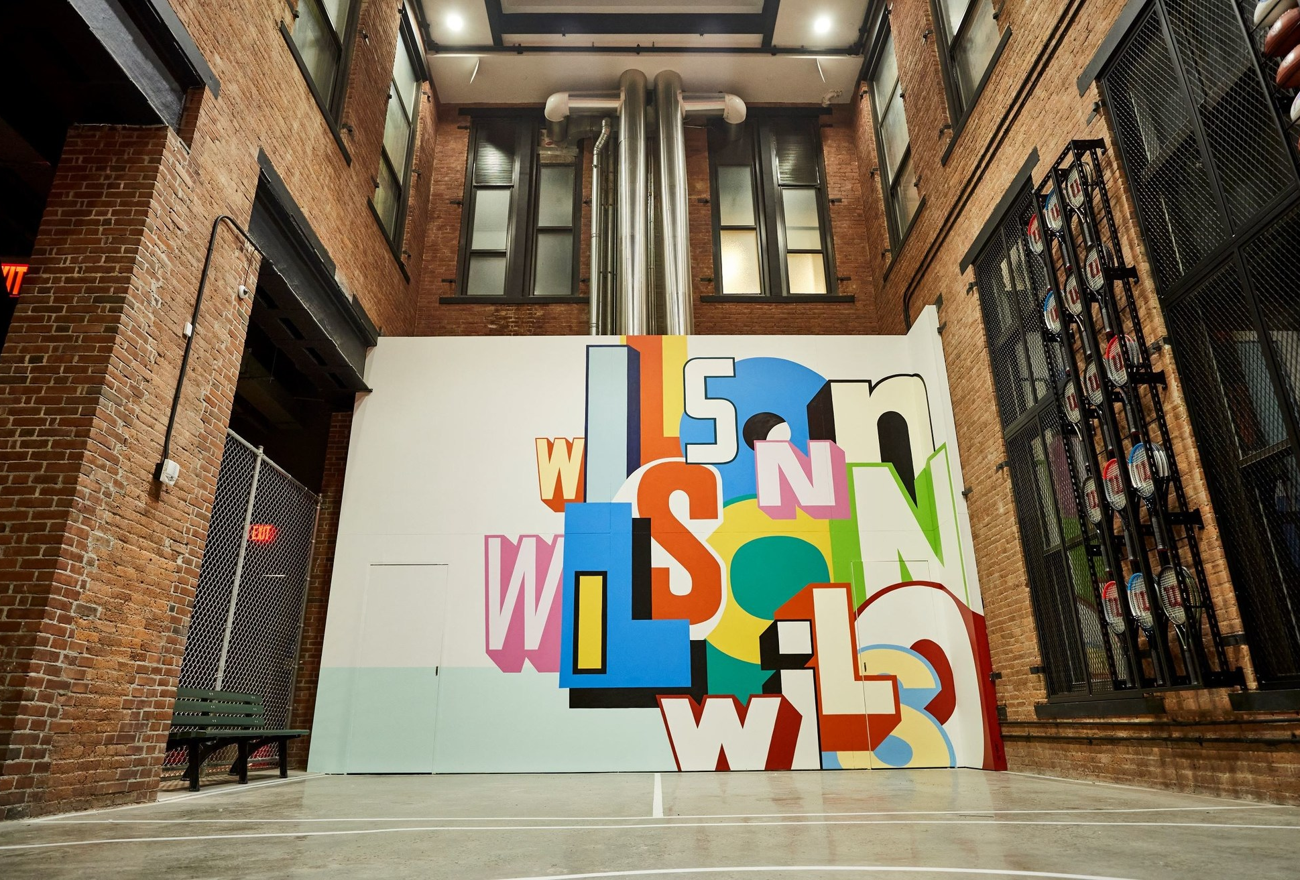
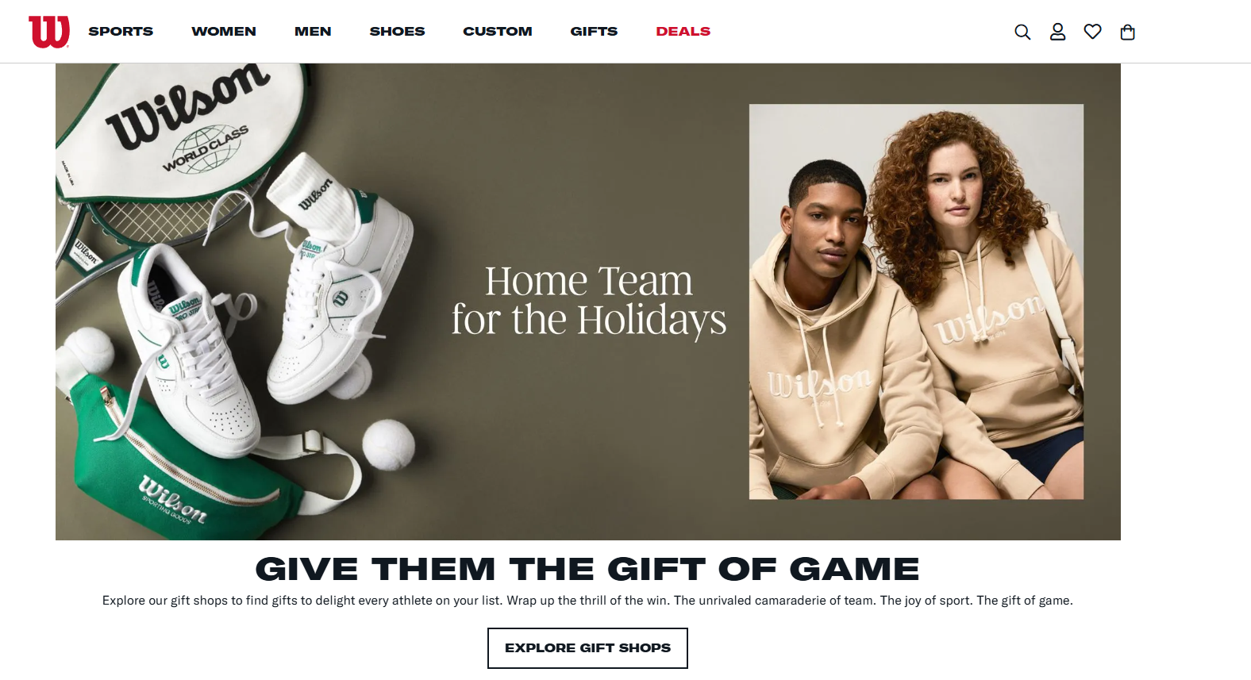
E-commerce Means
Direct-to-consumer
Third party online retailers
Omnichannel Integration
Personalization

Slide 12
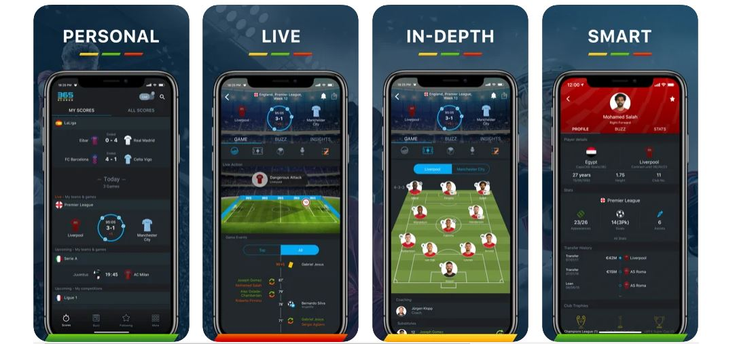
Future E-commerce Plan
Click-and-Collect and Store Integration
AI-Powered Customer Service
Augmented Reality (AR) &
Virtual Try-Ons

Slide 13
References
https://www.wilson.com/en-us/about/
https://en.wikipedia.org/wiki/Wilson_Sporting_Goods
https://incfact.com/company/

Slide 14


